Slide 1
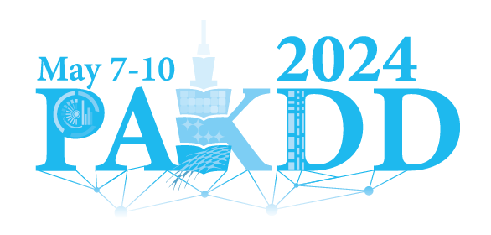
Enhancing Continuous Domain Adaptation with Multi-Path Transfer Curriculum
Hanbing Liu, Jingge Wang, Xuan Zhang, Ye Guo, Yang Li†
Tsinghua Shenzhen International Graudate School (SIGS), Tsinghua University

Slide 2
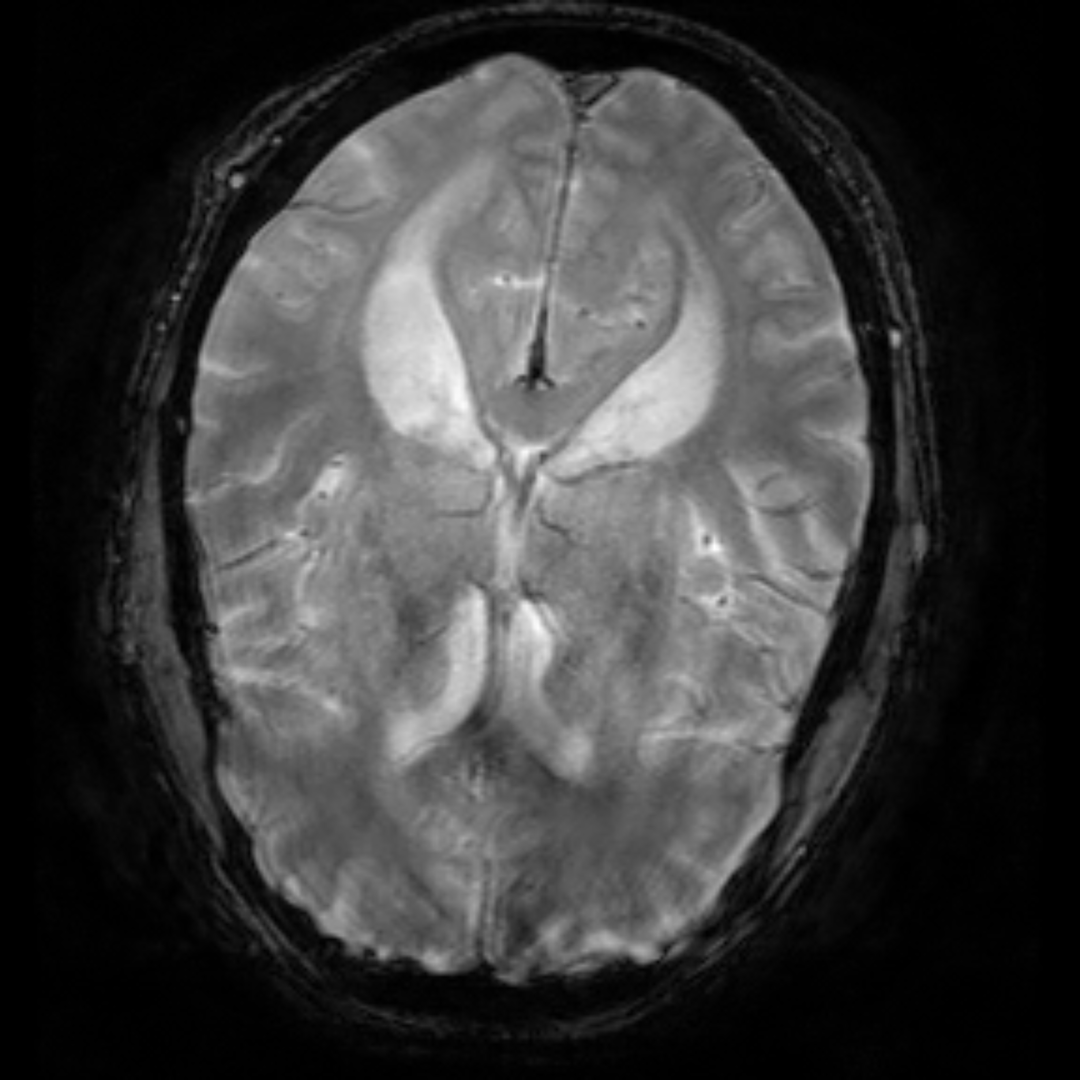
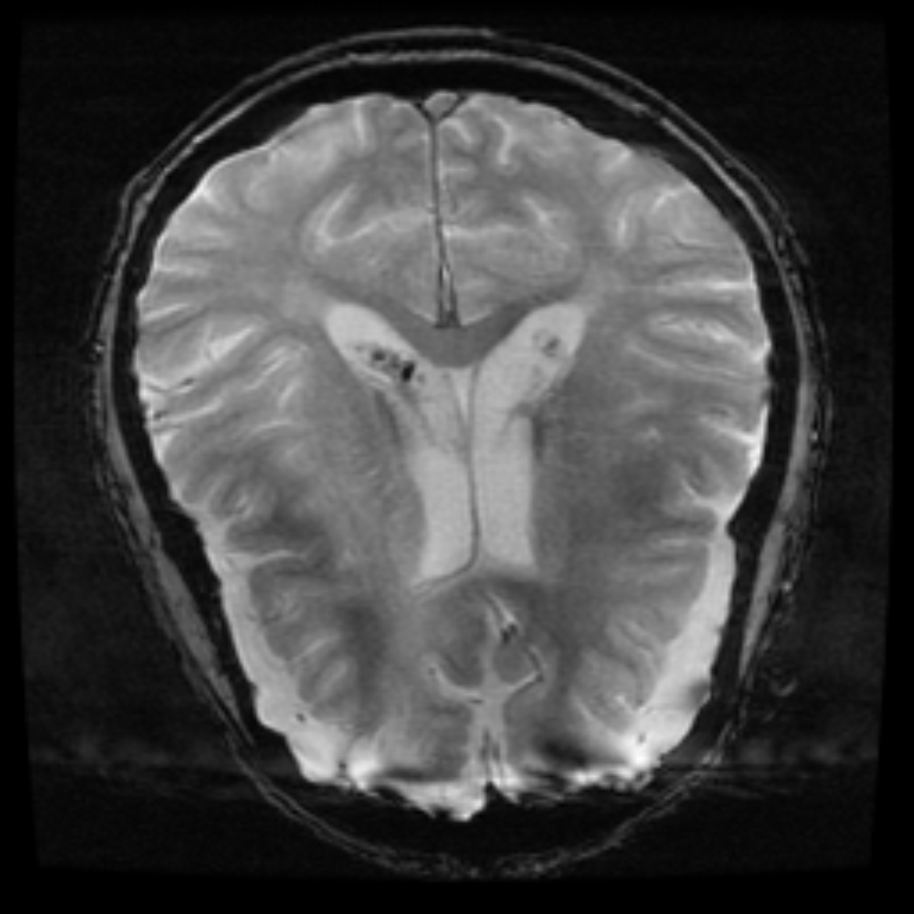
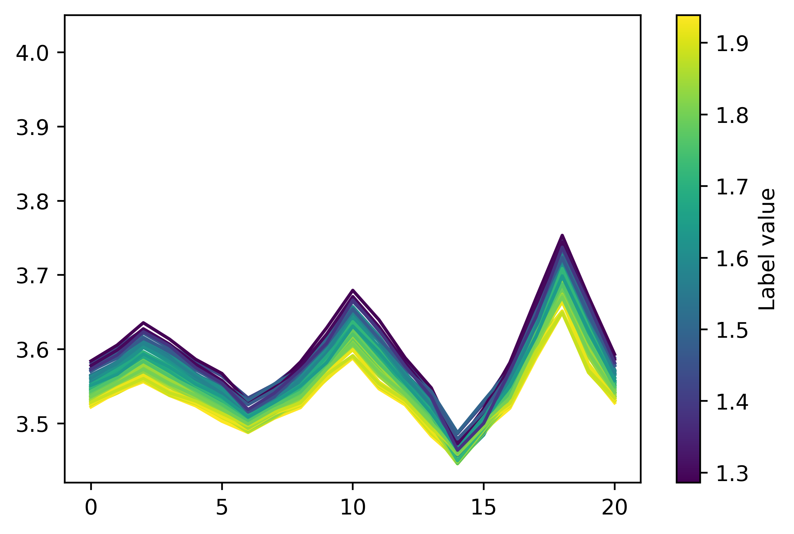
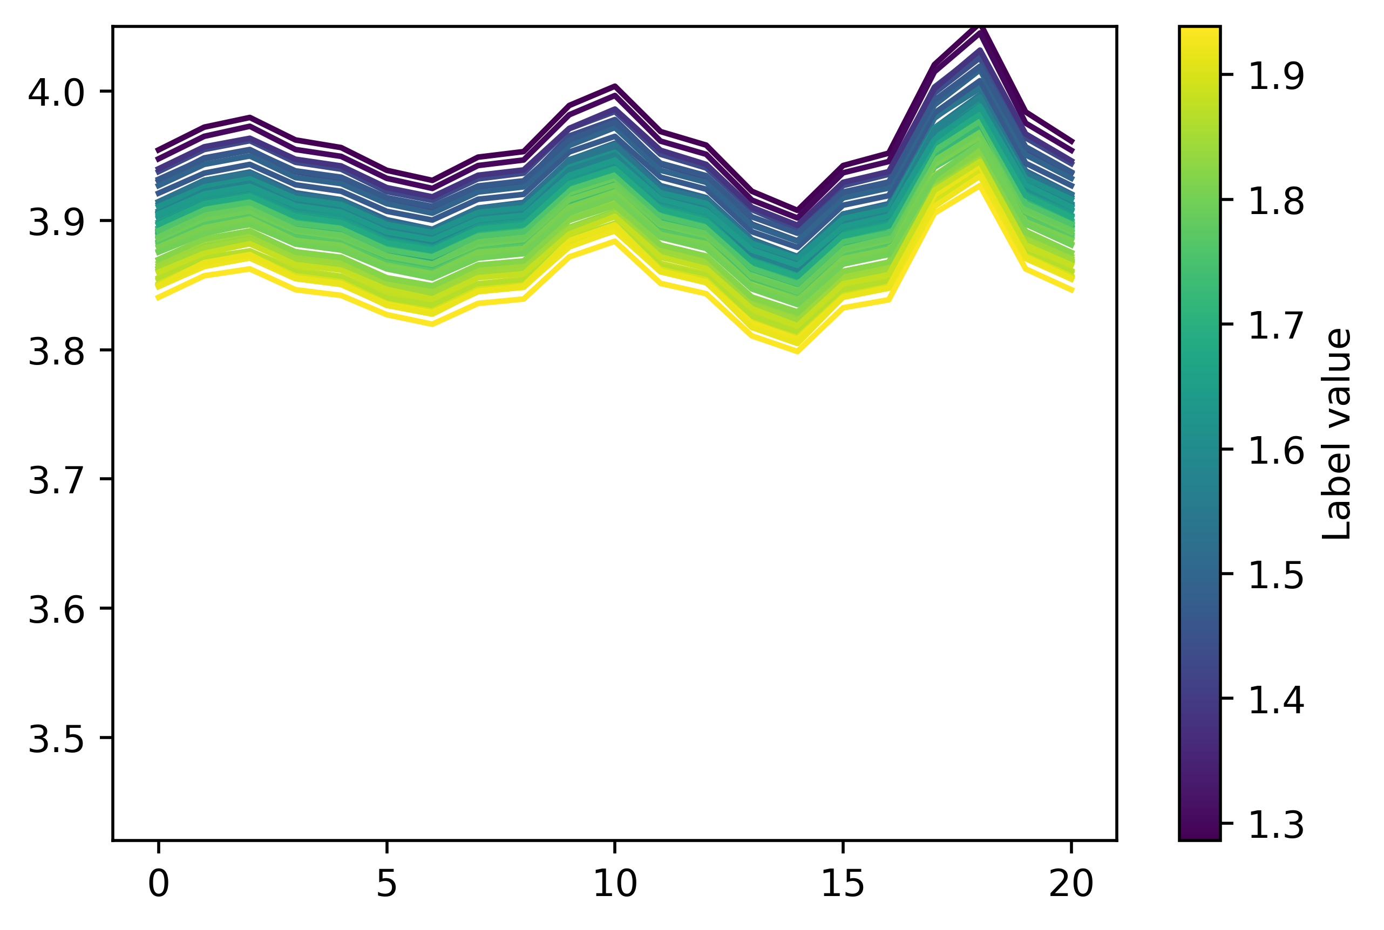
Unsupervised Domain Adaptation (UDA)
Introduction
Domain Adaptation
Leverages labeled data from the source domain to improve the learning performance on the unlabeled target domain
Labeled Source
UDA
Unlabeled Target
Alzheimer's classification of different patient group
Class 1
Class 1
Battery capacity estimation of
different charge stage
Traditional UDA’s performance is limited under large domain gap
[1] B. Sun, J. Feng, and K. Saenko, “Correlation alignment for unsupervised domain adaptation,” Domain adaptation in computer vision applications, pp. 153–171, 2017.
[2] N. Courty, R. Flamary, D. Tuia, and A. Rakotomamonjy, “Optimal transport for domain adaptation,” 2016.
Notes:
- Domain shift is a common challenge in real life machine learning applications - Unsupervised Domain Adaptation (UDA) has been proposed to leverage the labeled data from the source domain to improve the performance of learning models on the unlabeled target domain

Slide 3
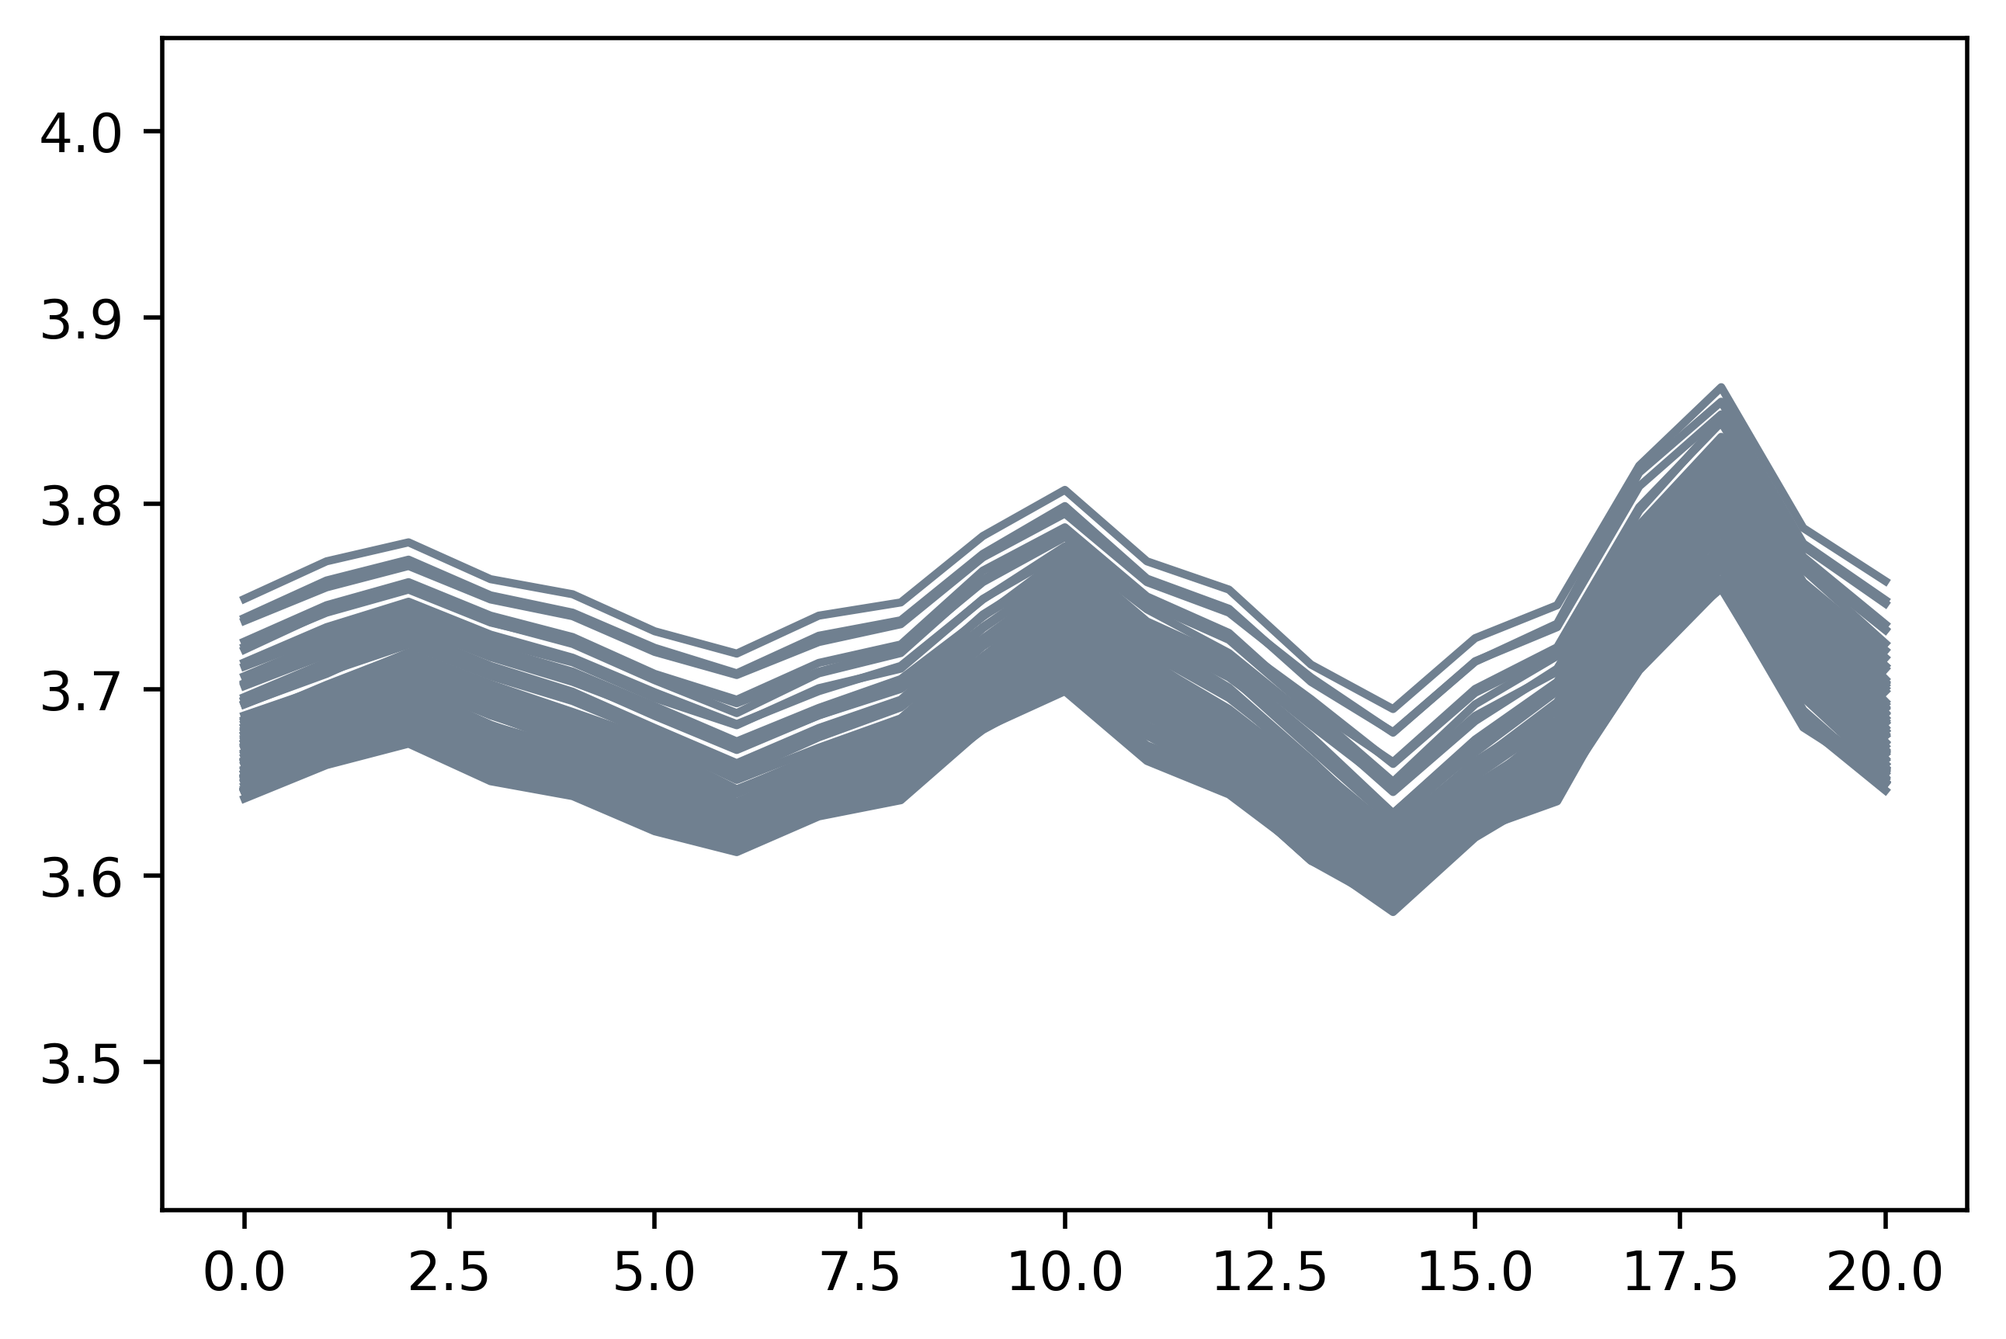
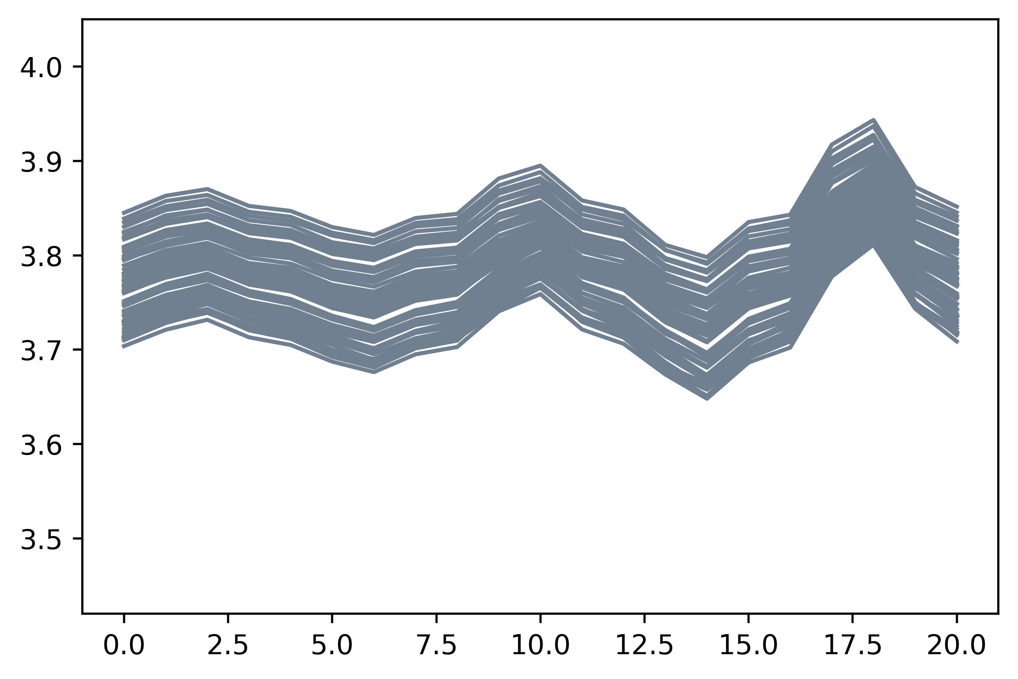
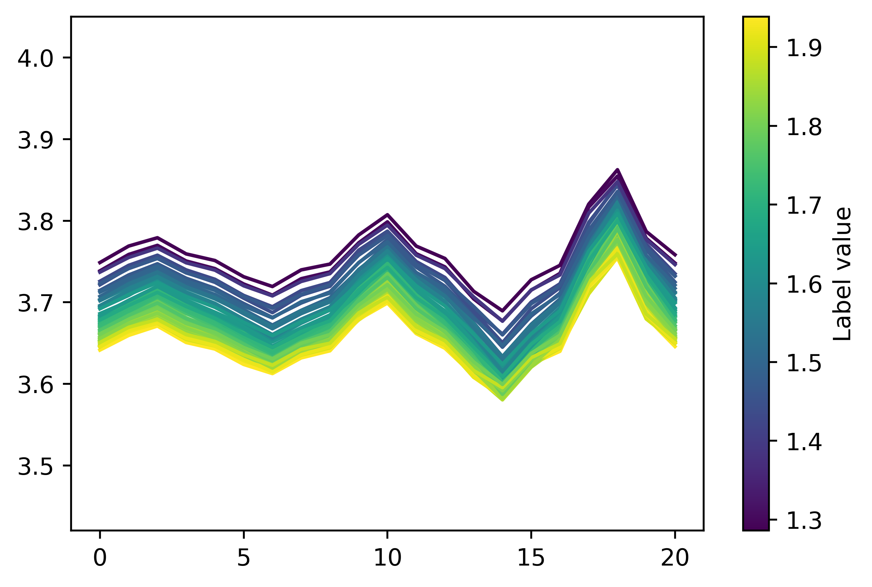
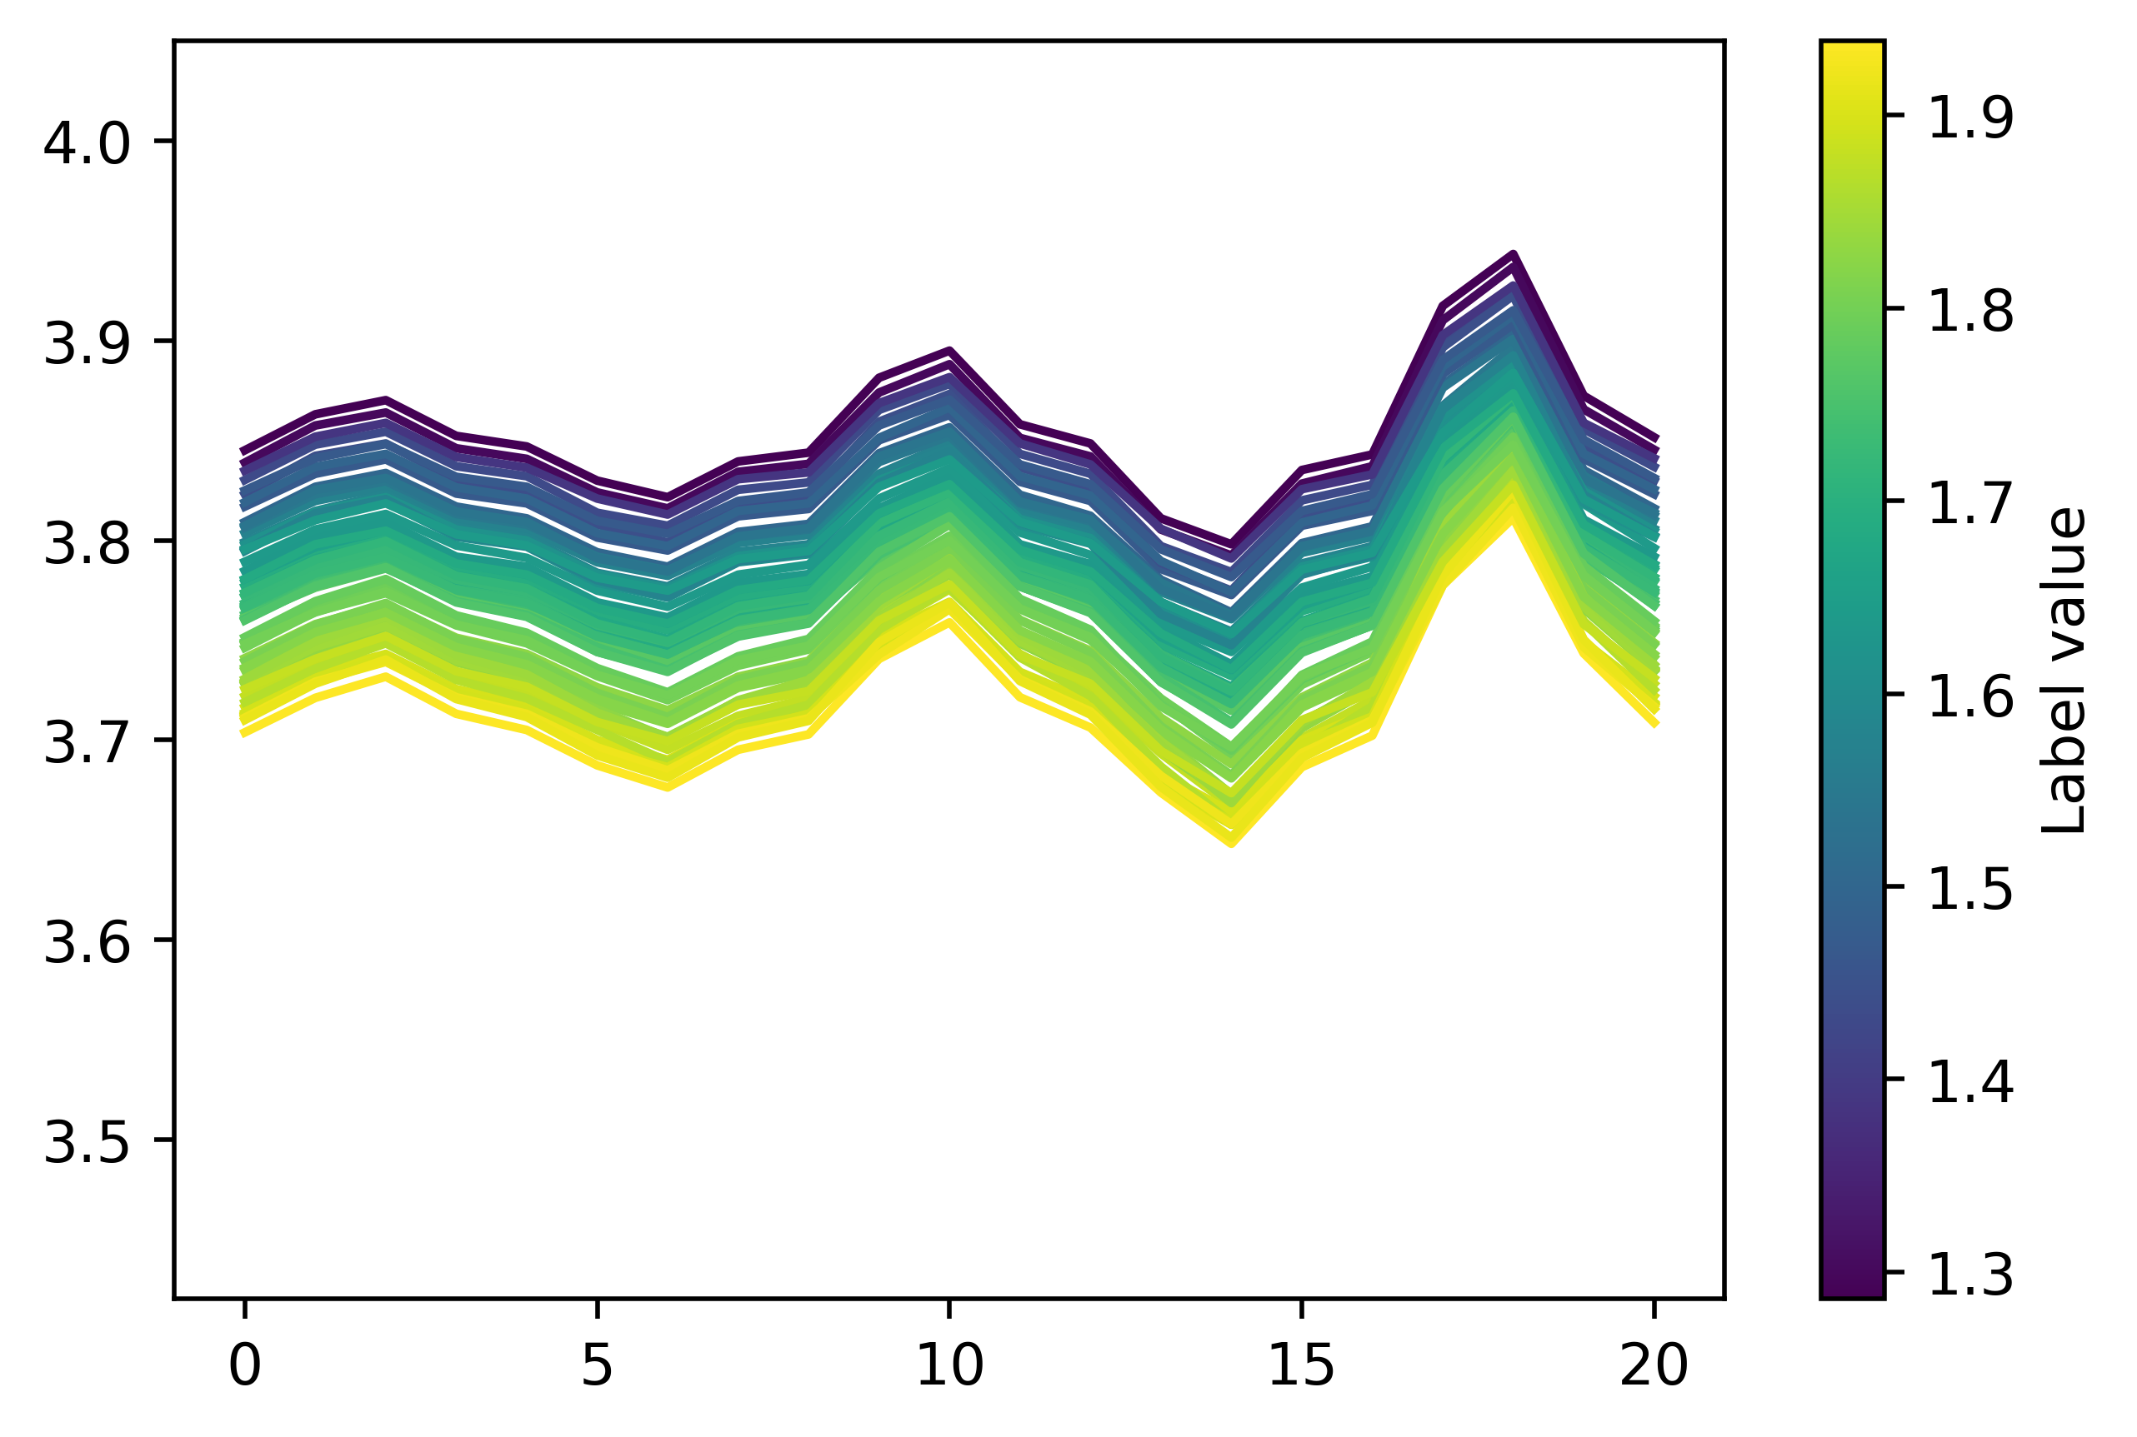
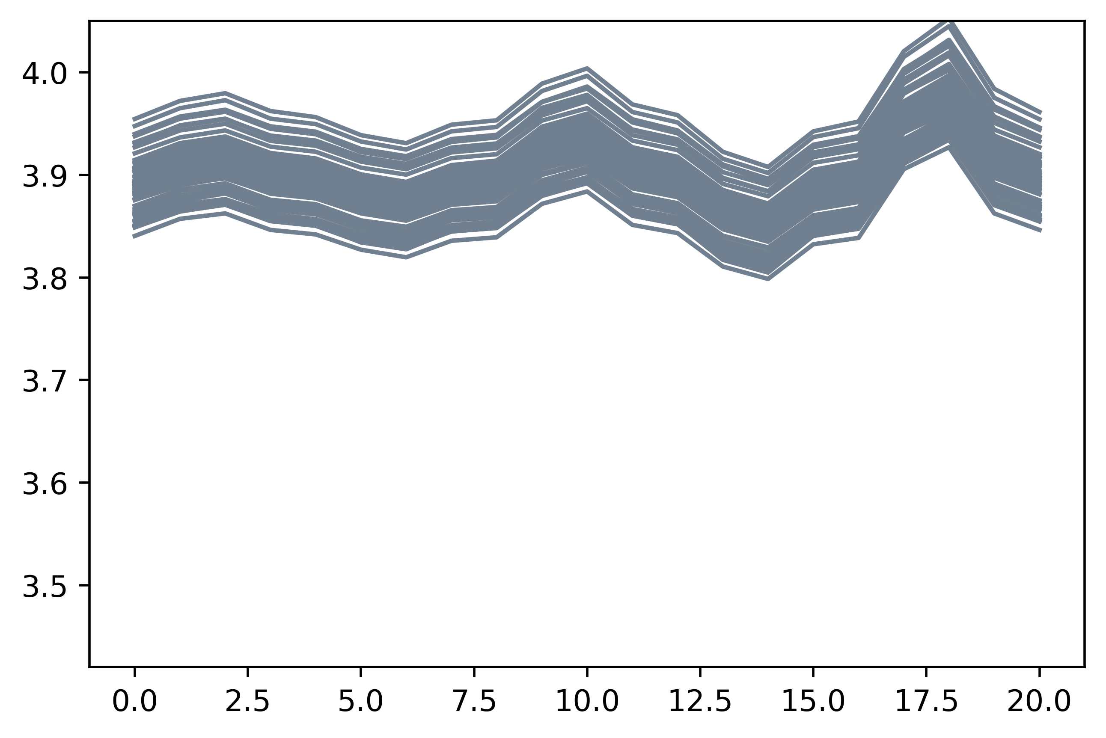
Continuous Domain Adaptation (CDA)
Introduction
Domain Adaptation
Adapt source data across large domain gap by incrementally adapting via auxiliary domains
Labeled Source Domain
Unlabeled Intermediate Domain 1
Unlabeled Intermediate Domain 2
Unlabeled Target Domain
Charge State
Previous Works
Self-training (Kumar 2020, Zhou 2022)
Adversarial learning (Wang 2020)
Continuous Optimal Transport (Ortiz-Jiménez 2020)
Kumar, T. Ma, and P. Liang, “Understanding self-training for gradual domain adaptation,” in International Conference on Machine Learning. PMLR, 2020
H. Wang, H. He, and D. Katabi, “Continuously indexed domain adaptation,” arXiv preprint arXiv:2007.01807, 2020
G. Ortiz-Jimlenez , et. al “Forward-backward splitting for optimal transport based problems,” in IEEE ICASSP, 2020
﻿Zhou, S. et. al. “Active gradual domain adaptation: Dataset and approach”. IEEE Transactions on Multimedia 24, 1210–1220, 2022
Notes:
Need to perform multiple adaptations -

Slide 4
Critical challenges of CDA
Introduction
Domain Adaptation
Requires domain meta data (e.g. age, charge stage) to order intermediate domains
Missing/inaccurate meta data
No semantic order
Prone to error accumulation in multi-step adaptation
Open-loop problem
Main Contribution: Propose a CDA Framework without domain meta data
Wasserstein-based transfer curriculum
Classification accuracy for Rotated MNIST
source
45º
90º
Multi-path Optimal Transport
H. Wang, H. He, and D. Katabi, “Continuously indexed domain adaptation,”， arXiv preprint arXiv:2007.01807, 2020.

Slide 5
Contents
Contents
Outline
Introduction
Method: W-MPOT
Problem definition
Background
Wasserstein transfer curriculum
Multi-path constraints
Experimental analysis
Discussion
Notes:
UDA
DA
Challenges
Key contributions
---------
Method
0. Formal Problem Definition
COT
Wasserstein Curriculum (Why?)
Multi-path consistency
Results

Slide 6
Problem definition
Method
Problem
Source $D_{S}$
Auxiliary Domain Set $D_{I}$
Target $D_{T}$
0°
180°
labeled
unlabeled
Givens
Source domain $D_{S}={\left\{\left(x_{j}, y_{j}\right)\right\}}_{j=1}^{N_{S}}$ , $x_{j}∼μ_{s}$
Target domain $D_{T}={\left\{x_{j}\right\}}_{j=1}^{N_{T}} , x_{j}∼μ_{t}$
Auxiliary domains $𝒟_{I}=\left\{D_{I_{1}},D_{I_{2}},D_{I_{3}},…,D_{I_{K}}\right\},$ $D_{I_{k}}={\left\{x_{j}\right\}}_{j=1}^{N_{I_{k}}}$
Objective
Intermediate domain sequence ${\hat{𝒟}}_{I}={\hat{𝒟}}_{I_{1} }→…→{\hat{𝒟}}_{I_{N}}⊆D_{I}$
Predict target domain label ${\left\{\hat{y_{j}}\right\}}_{j=1}^{N_{T}}$
Notes:
Given a source domain of Ns labeled training samples, each feature x has distribution mu_s
a target domain of Nt unlabeled training samples x has distribution mu_t
A set of K auxiliary domains without label that can use as intermediates
Objective: find a optimal intermediate domain sequence from the auxiliary domain
And train a model that predict target domain label

Slide 7
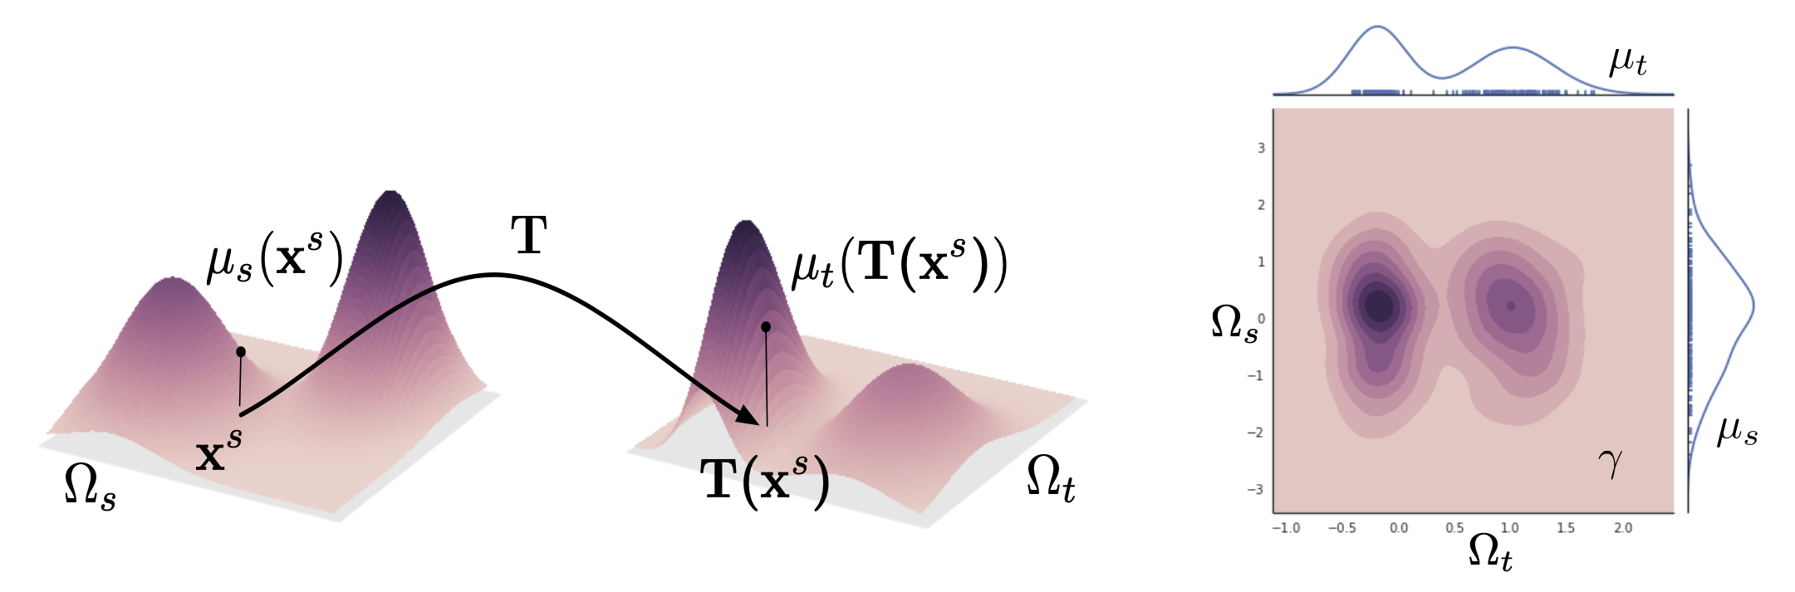
Optimal Transport for Domain Adaptation (Courty 2016)
Method
Background
Given feature distributions $μ_{s}, μ_{t}$
Find optimal mapping T by solving the Kantorovich relaxation of optimal transport
$$T\left(X_{s}\right)=diag {\left(γ_{0}1\right)}^{−1}γ_{0}X_{T}$$
$$﻿N_{S} γ_{0} {\hat{D}}_{{ I}_{1}}$$
Cost function between $μ_{s}$ and $μ_{t}$
Entropy regularizer
Train model using transported source data $D_{s}^{t}=T(X_{s})$and label $Y_{s}$
$$γ_{0}$$
Strong theoretical guarantee
Good practical performance
efficiency
N. Courty, R. Flamary, D. Tuia, and A. Rakotomamonjy, “Optimal transport for domain adaptation,” 2016.
Notes:
Optimal transport finds a probabilistic coupling between two distributions mu_s, mu_t

Slide 8
Continuous Domain Optimal Transport (Ortiz-Jiménez 2020)
Method
Background
Given N+1 distributions: $μ_{0}=μ_{s}, μ_{1}, …,{ μ}_{N},μ_{N+1}=μ_{t}$
Cost function between $μ_{t}$ and $μ_{t+1}$
$$γ_{t}$$
Temporal regularization
$$R_{t}\left(γ\right)=||T_{γ_{t}}\left(D_{S}^{I_{t−1}}\right)−T_{γ_{t}}\left(D_{S}^{I_{t−2}}\right)||_{F}^{2}$$
Train model using transported source data $T_{γ_{T−1}}∘…∘T_{γ_{1}}∘T_{γ_{0}}(x_{s})$and label $y_{s}$
Transported source features
Can be solved efficiently using the a modified Sinkhorn algorithm
G. Ortiz-Jiménez, M. El Gheche, E. Simou, H. P. Maretic ́ , and P. Frossard, “Forward-backward splitting for optimal transport based problems,” in IEEE ICASSP, 2020, pp. 5405–5409.
Notes:
Optimal transport finds a probabilistic coupling between two distributions mu_s, mu_t

Slide 9
Wasserstein-based transfer curriculum
Method
W-MPOT
Calculate the w-distance between each intermediate domain $D_{I_{k}}$ and the source domain $D_{S}$
Discard any intermediate domain that is further from the target domain
Sort in order of $W_{k}$ to get intermediate domain sequence ${\hat{𝒟}}_{I}$
Eliminate the need for meta-information
(Wasserstein distance condition)
0°
18°
90°
180°
$$𝒲_{1}$$
$$𝒲_{2}$$
$$𝒲_{3}$$

Slide 10
Why use a Wasserstein-based curriculum?
Method
W-MPOT
1-Wasserstein distance plays an important role in the generalization bound in domain adaptation
Two candidate intermediate domains $D_{I_{1}}$ and $D_{I_{2}}$
Assume C: $D_{S}→D_{I_{1}}→D_{I_{2}}→D_{T}$strictly satisfies Wasserstein distance condition on a 1D manifold
Now consider swapping intermediate domains C’: $D_{S}→D_{I_{2}}→D_{I_{1}}→D_{T}$
Better domain transfer order will lead to tighter generalization bound
$$μ_{I_{2}}$$
$$μ_{I_{1}}$$
$$μ_{s}$$
$$μ_{T}$$
Target generalization bound of C and C’:
Our assumption implies $𝒲_{1}\left(μ_{S},μ_{I_{1}}\right)<𝒲_{1}\left(μ_{S},μ_{2}\right)$ and $𝒲_{1}\left(μ_{2_{1}},μ_{T}\right)<𝒲_{1}\left(μ_{I_{1}},μ_{T}\right)$
Notes:
Our assumption implies $𝒲_{1}\left(μ_{S},μ_{I_{1}}\right)<𝒲_{1}\left(μ_{S},μ_{2}\right)$ and $𝒲_{1}\left(μ_{2_{1}},μ_{T}\right)<𝒲_{1}\left(μ_{I_{1}},μ_{T}\right)$

Slide 11
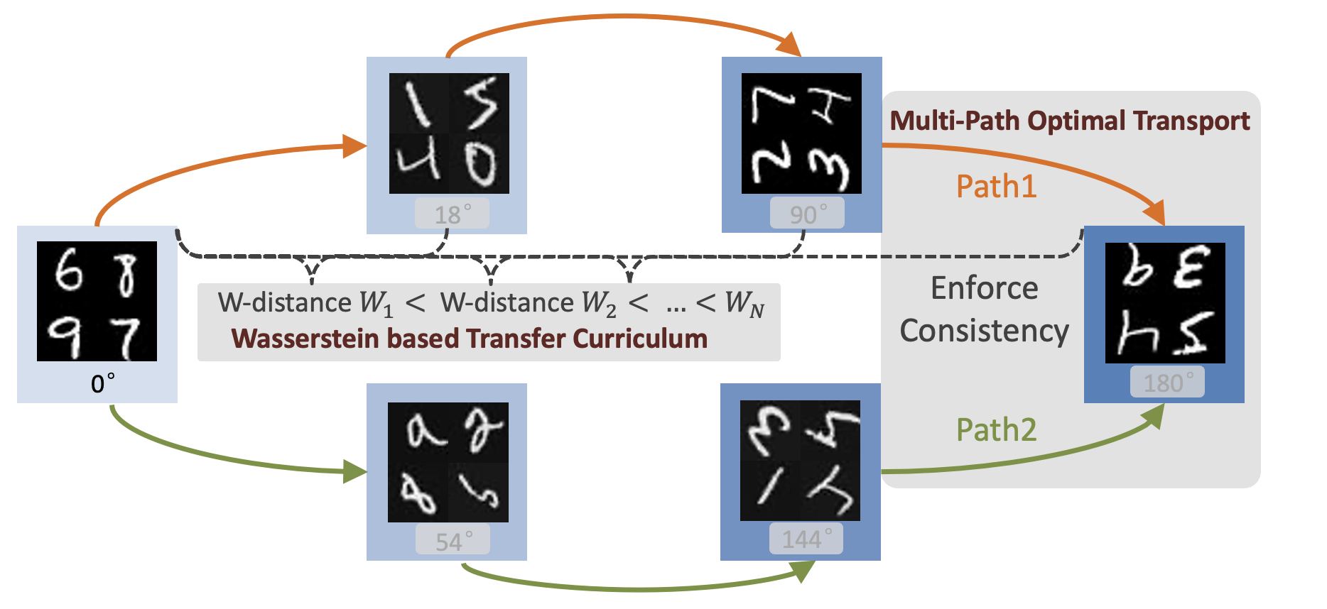
Mitigating Cumulative Error using Multi-path Consistency
Method
W-MPOT
Sample multiple paths in the sorted domain sequence
Add path-consistency regularization at the last intermediate domain in each path
$$R_{p}(⋅)$$
Enforce consistency between source projection from multiple transport paths

Slide 12
Multi-Path Optimal Transport (MPOT)
Method
W-MPOT
For the last intermediate domain ${\hat{D}}_{I_{N}}$ : solve multi-path optimal transport
Path consistency regularizer:
transport plan of second path $p_{2}$
MPOT mapped source samples is better at preserving target domain geometry

Slide 13
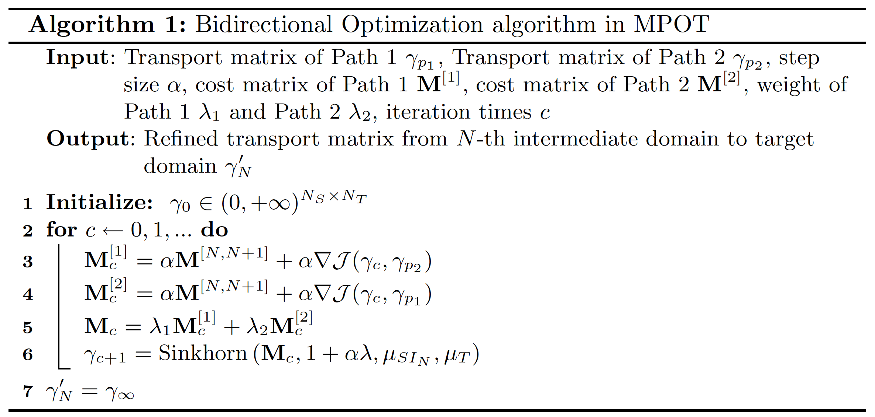
Numerical Optimization of MPOT
Method
W-MPOT
Bidirectional regularization for $R_{p}(⋅)$
Each path imposes constraints to the learning of the other path
Two paths are jointly optimized

Slide 14
Contents
Contents
Outline
Introduction
Method: W-MPOT
Problem definition
Background: Continuous optimal transport
Wasserstein transfer curriculum
Multi-path constraints
Experimental analysis
Discussion
Notes:
UDA
DA
Challenges
Key contributions
---------
Method
0. Formal Problem Definition
COT
Wasserstein Curriculum (Why?)
Multi-path consistency
Results

Slide 15
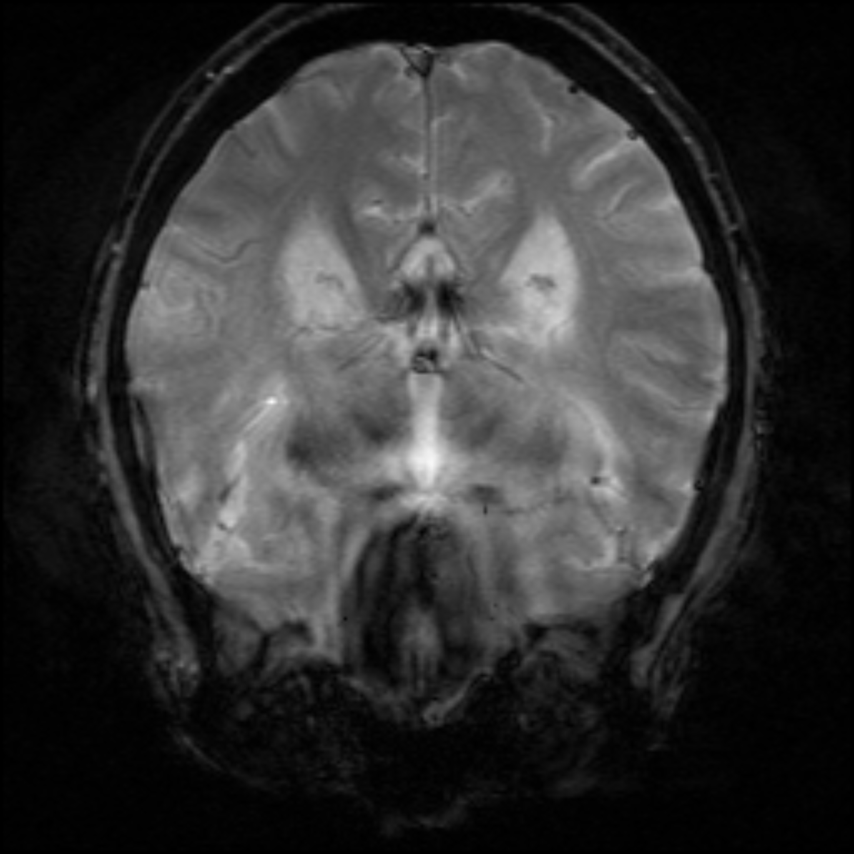
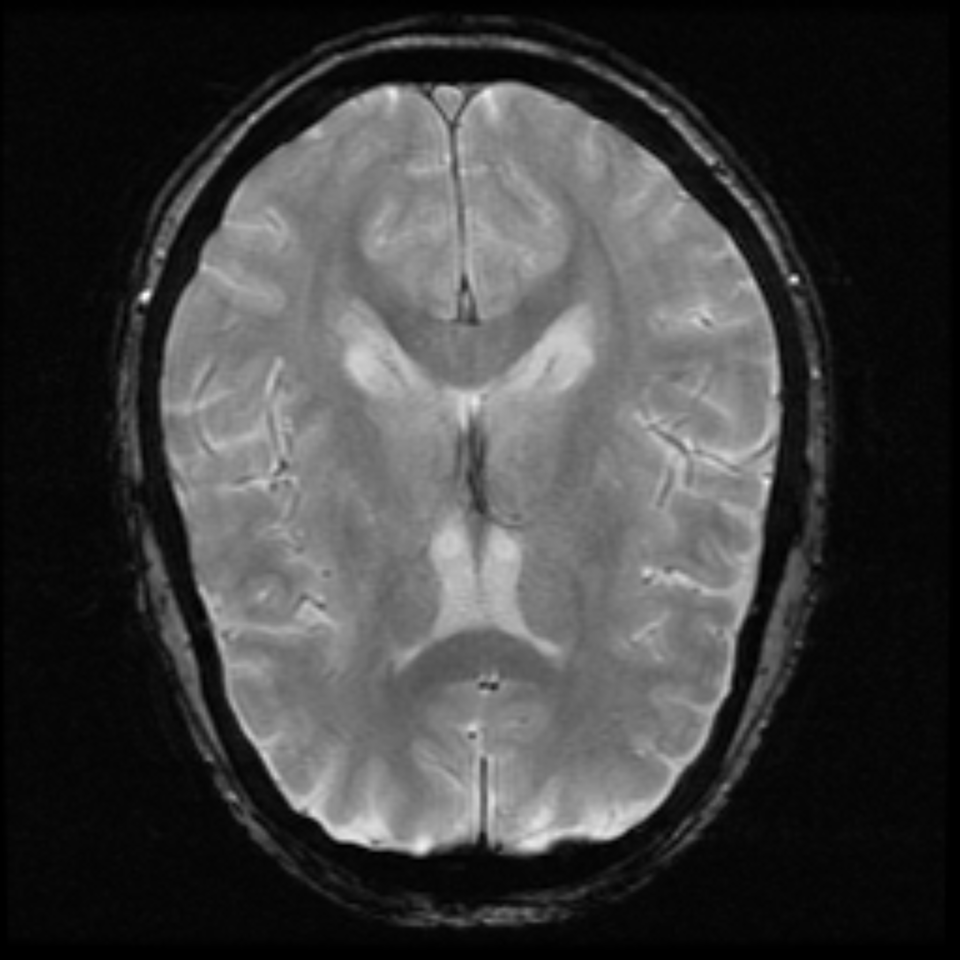
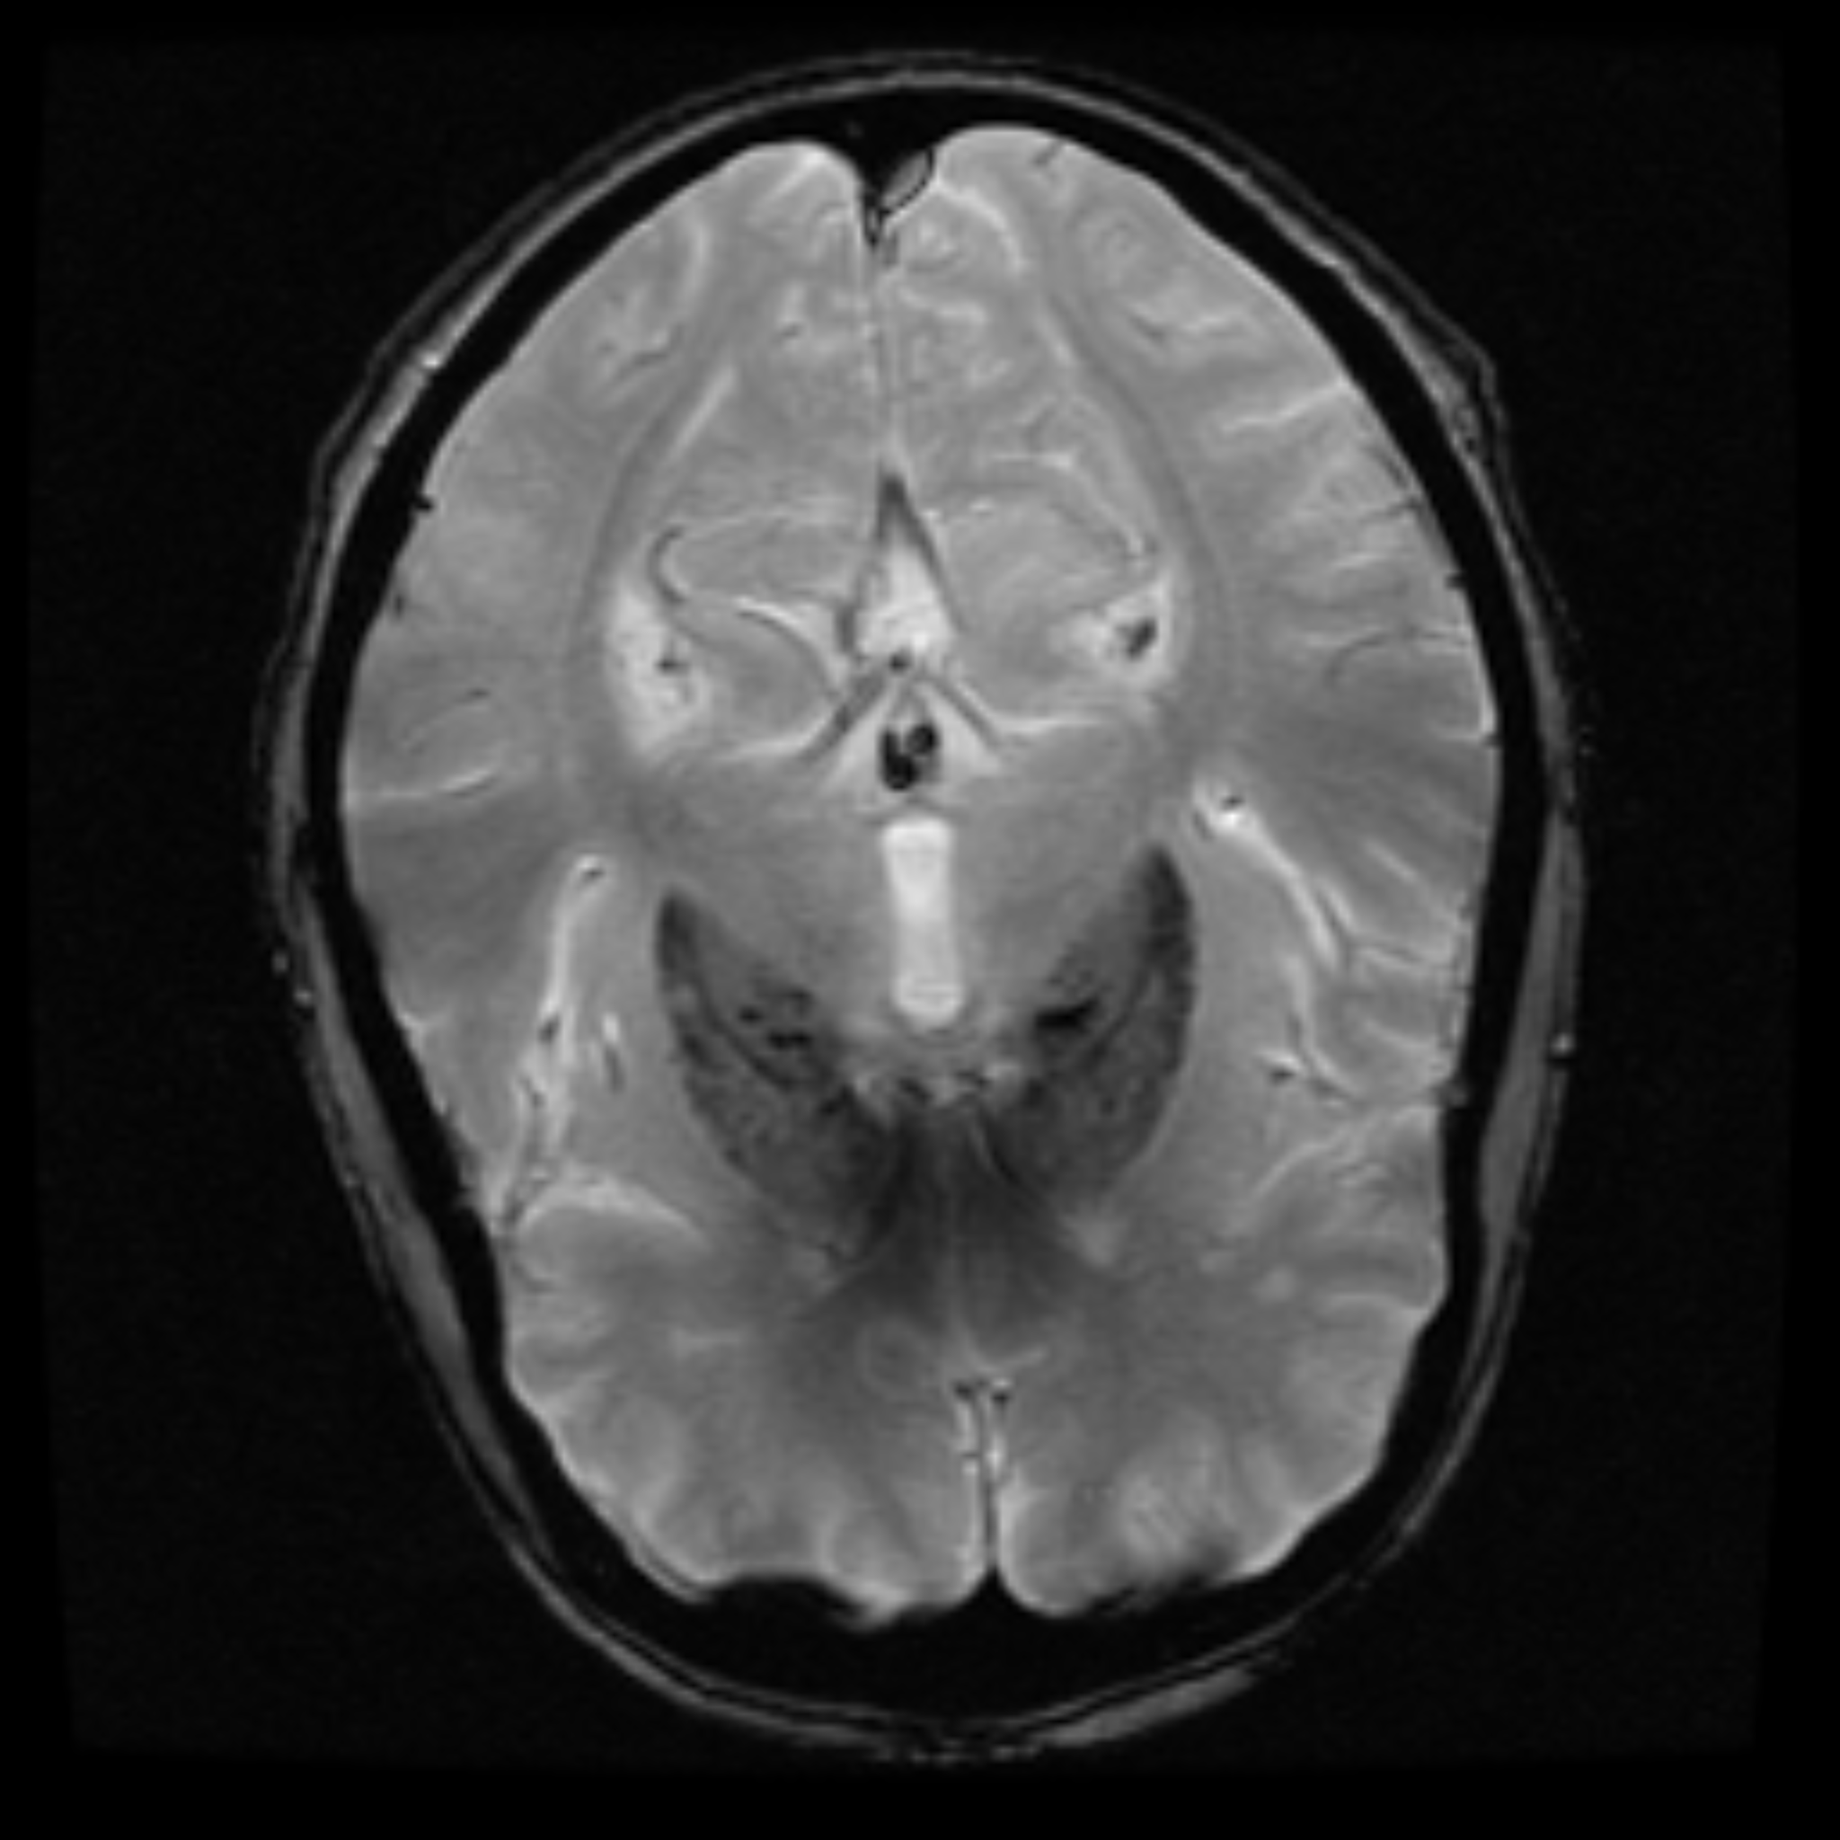
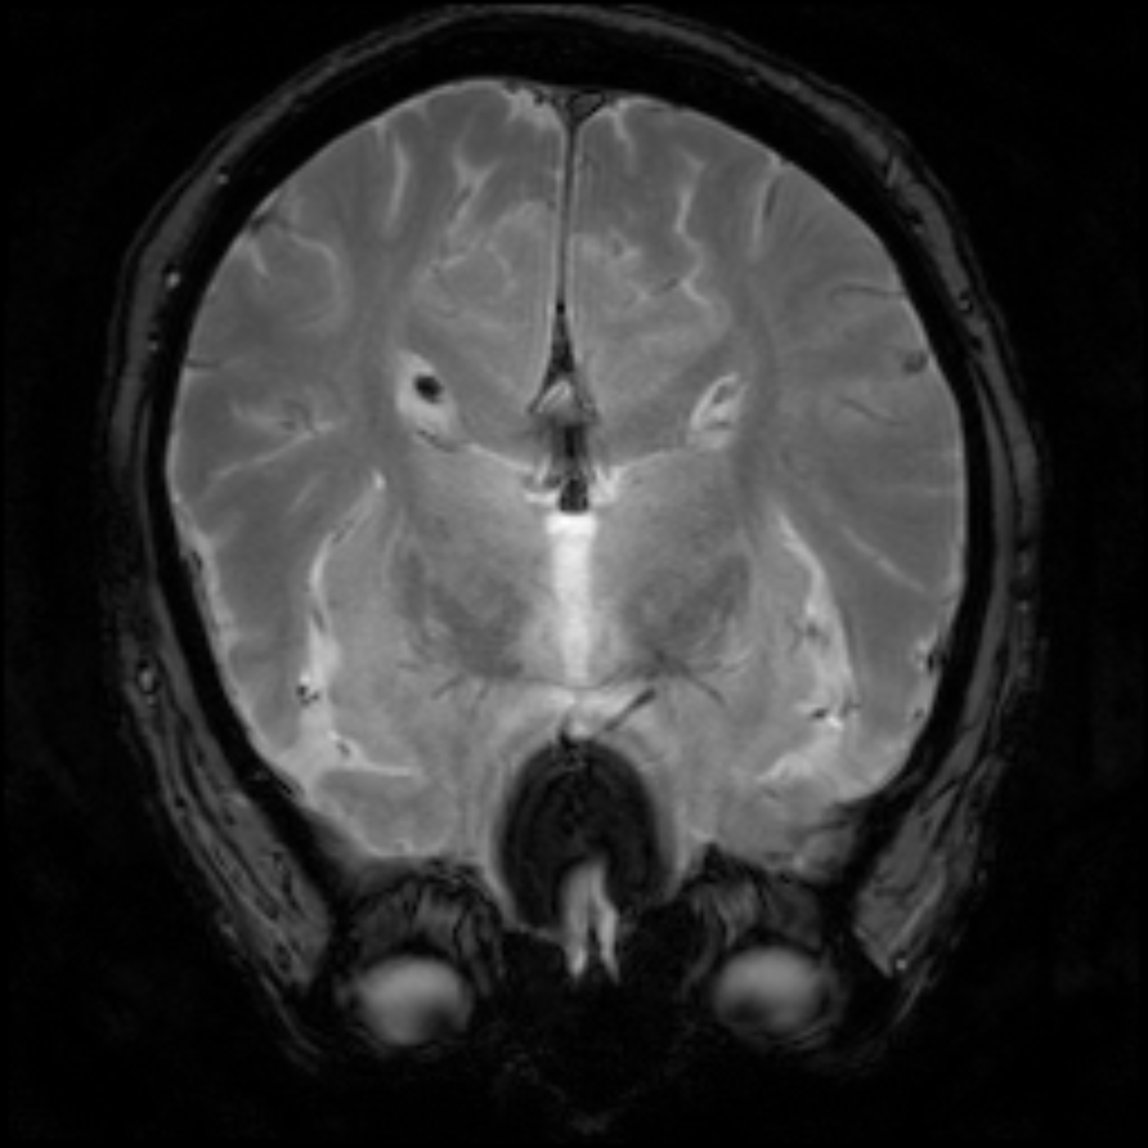
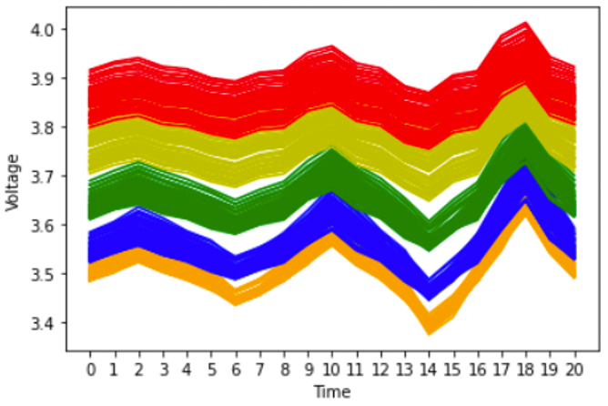
Datasets and Experimental Settings
Experiment
Datasets
The Alzheimer’s Disease Neuroimaging Initiative (ADNI)
Source domain (ages 50–70, 190 samples)
6 intermediate domains (ages 70–72, 72–74, 74–76, 76–78, 78–82, 82–92, 50 samples each)
Battery Charging-Discharging Capacity
Source domain (5% SoC, 67 samples)
9 intermediate domains (10%–50% SoC, 10 samples each)
Rotated MNIST
Source domain (0 degree, 1000 samples)
9 intermediate domains (18, 36, 54, 72, 90 degree, 250 samples each)
0°
18°
90°
180°

Slide 16
Q1: How good is the Wasserstein-Based Transfer Curriculum?
Experiment
Results
Comparable performance between COT utilizing w-distance and COT with ground truth domain metadata
Significantly outperforms direct optimal transport (DOT) adaptation
Notes:
Compare Wass. Curriculum (Red) with Curriculum using ground truth meta data (light brown).
Lower the better.
ANDI dataset when the meta data is not that clearly defined, it is actually better for longer transfer sequence
Both methods are sig better than direct transfer to target domain

Slide 17
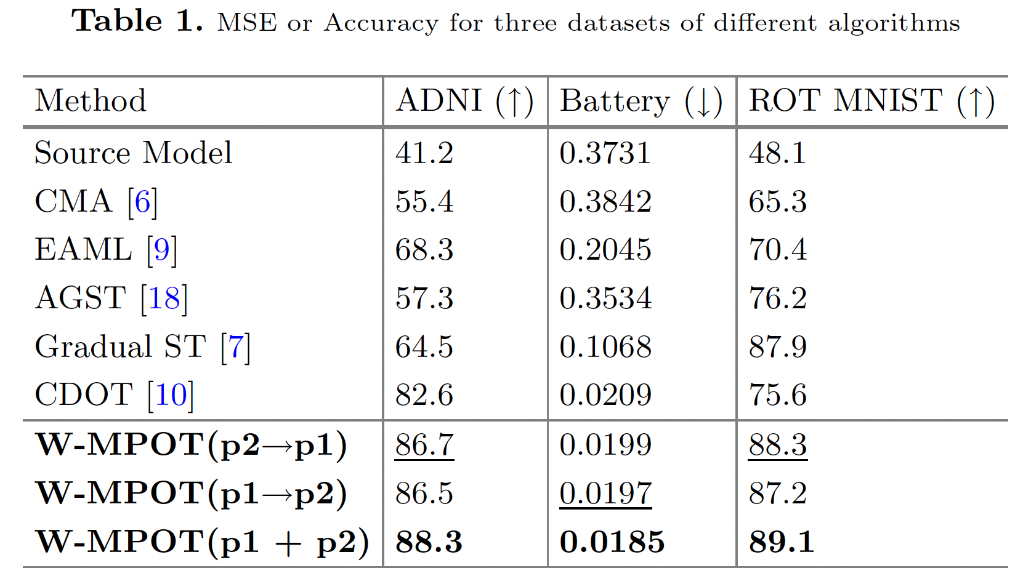
Q2: W-MPOT’s Effectiveness on CDA
Experiment
Results
W-MPOT achieves the best performance
Bidirectional multipath regularization shows best improvement
Path consistency makes model more robust

Slide 18
Further Experimental Validations
Experiment
Results
Is Domain Partition necessary? Yes
Is the order of intermediate domain important?
Yes – especially for sparse sequences
(Battery Dataset)

Slide 19
Conclusion and future work
Discussion
Conclusion
Present a comprehensive framework W-MPOT for CDA
Determine the order of intermediate domains by construct a Wasserstein-based transfer curriculum
Minimize the impact of cumulative errors and enhance the overall robustness by enforcing consistency along multiple adaptation paths
Future work
Better transfer curriculum for multi-variate domain shift
Learn optimal transfer path through reinforcement learning

Slide 20
Thank You for Listening!

